Slide 1
NIH Treatment Guidelines
Update
January 4, 2022

Slide 2
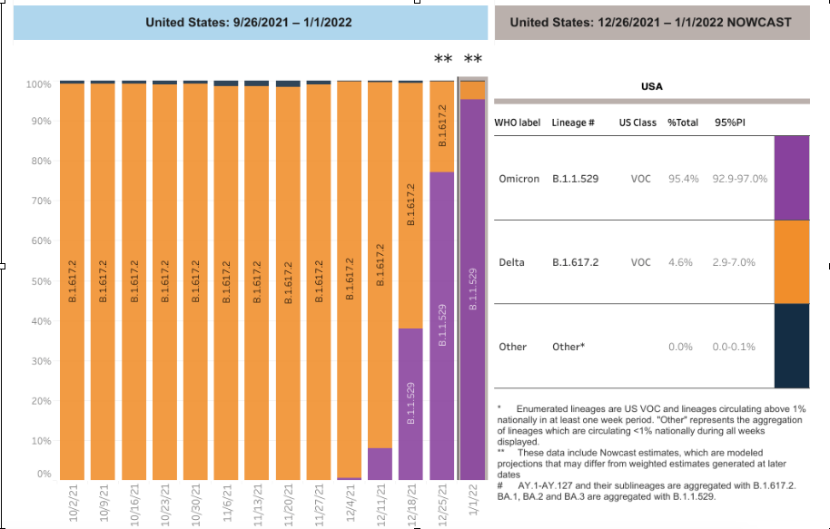
Where are we: CDC NOWCAST 1/1/2022

Slide 3
Recommendation for nonhospitalized patients with mild to moderate COVID-19 who are at high risk of disease progression:
(listed in order of preference)
Nirmatrelvir 300 mg with ritonavir 100 mg (Paxlovid) orally twice daily for 5 days
Sotrovimab 500 mg as a single IV infusion
Remdesivir 200 mg IV on Day 1, followed by remdesivir 100 mg IV daily on Days 2 and 3
Molnupiravir 800 mg orally twice daily for 5 days, initiated as soon as possible and within 5 days of symptom onset in those aged ≥18 years ONLY when none of the above options can be used

Slide 4
Caution:
Clinicians who are not experienced in prescribing ritonavir-boosted drugs should refer to resources such as the EUA fact sheet for ritonavir-boosted nirmatrelvir (Paxlovid) and the Liverpool COVID-19 Drug Interactions website for additional guidance. Consultation with an expert (e.g., clinical pharmacist, HIV specialist, and/or the patient’s specialist provider[s], if applicable) should also be considered.

Slide 5
Strategies When There Are Logistical or Supply Constraints:
When it becomes necessary to triage patients for receipt of anti-SARS-CoV-2 therapies or preventive strategies, the Panel suggests prioritizing:
Treatment of COVID-19 over post-exposure prophylaxis (PEP) of SARS-CoV-2 infection.
Treatment of COVID-19 in unvaccinated or incompletely vaccinated individuals with clinical risk factors for severe illness and vaccinated individuals who are not expected to mount an adequate immune response (see Immunocompromising Conditions).
Use of tixagevimab plus cilgavimab (Evusheld) as pre-exposure prophylaxis (PrEP) for severely immunocompromised individuals over moderately immunocompromised individuls.

Slide 6
Risk Groups
Tier 1
  Immunocompromised individuals not expected to mount an adequate immune response to COVID-19 vaccination or SARS-CoV-2 infection due to their underlying conditions, regardless of vaccine status (see Immunocompromising Conditions); or
  Unvaccinated individuals at the highest risk of severe disease (anyone aged ≥75 years or anyone aged ≥65 years with additional risk factors).
Tier 2
  Unvaccinated individuals at risk of severe disease not included in Tier 1 (anyone aged ≥65 years or anyone aged <65 years with clinical risk factors)

Slide 7
Tier 3
  Vaccinated individuals at high risk of severe disease (anyone aged ≥75 years or anyone aged ≥65 years with clinical risk factors)
  Note: Vaccinated individuals who have not received a COVID-19 vaccine booster dose are likely at higher risk for severe disease; patients in this situation within this tier should be prioritized for treatment.
Tier 4
  Vaccinated individuals at risk of severe disease (anyone aged ≥65 years or anyone aged <65 with clinical risk factors)
  Note: Vaccinated individuals who have not received a COVID-19 vaccine booster dose are likely at higher risk for severe disease; patients in this situation within this tier should be prioritized for treatment.

